Slide 1
MODULE 1 HUMAN AND NATURE The roles of producers and consumers on the natural balance FRANCE

Slide 2
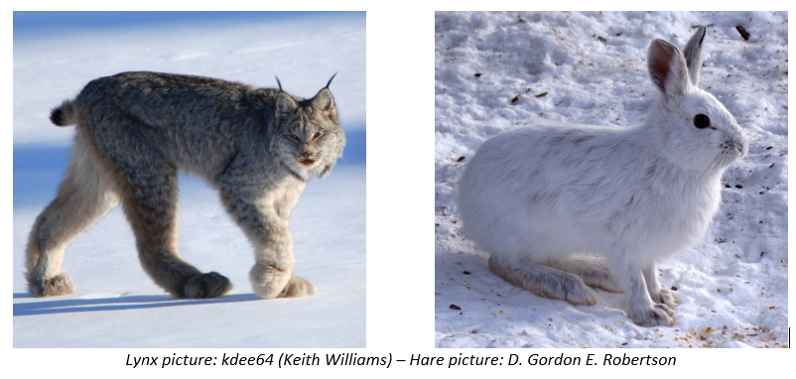
Snowshoe hare (Lepus americanus) are the primary food for the Canadian lynx (Lynx canadensis) in the Northern boreal forests of North America. When hare is abundant, Lynx will eat hare about two every three days almost to the complete exclusion of other foods.

Slide 3
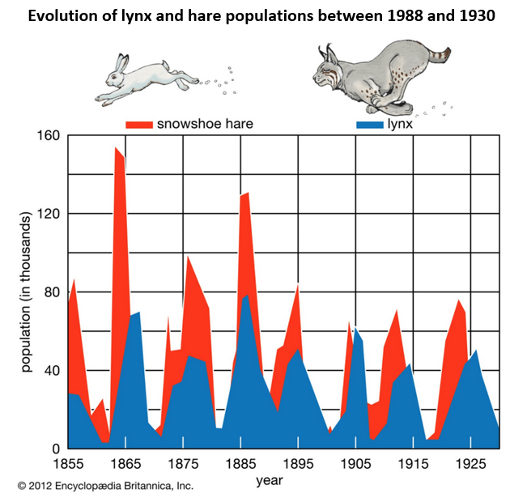
Study the case of the lynx and the Canadian hare to show that nature has a delicate balance

Slide 4
Funded by the European Union. Views and opinions expressed are however those of the author(s) only and do not necessarily reflect those of the European Union or the European Education and Culture Executive Agency (EACEA). Neither the European Union nor EACEA can be held responsible for them

