Slide 1
MODULE 1 HUMAN AND NATURE The roles of producers and consumers on the natural balance FRANCE

Slide 2
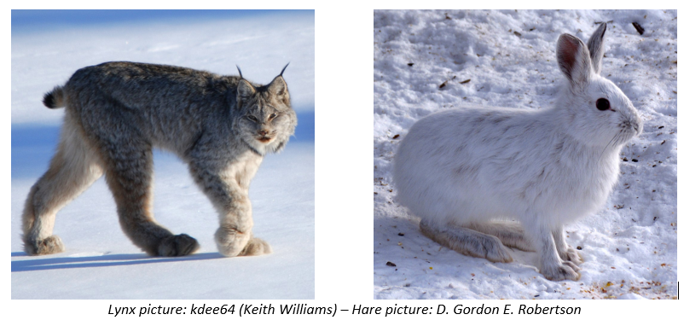
Snowshoe hare (Lepus americanus) are the primary food for the Canadian lynx (Lynx canadensis) in the Northern boreal forests of North America. When hare is abundant, Lynx will eat hare about two every three days almost to the complete exclusion of other foods.

Slide 3
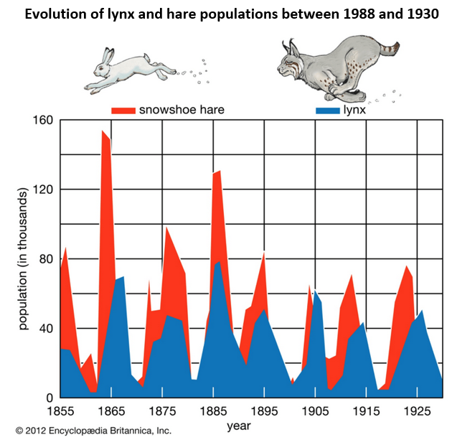
Study the case of the lynx and the Canadian hare to show that nature has a delicate balance

