Slide 1
DigiProf project Training Material O3 Unit 2.3.
DHBW
Transparent Assessment in EU MicroCredentials Example with ECCOE template

Slide 2
Example of MicroCredential Features demonstrating transparency of assessment
Transparent Assessment from ECCOE CREDENTIAL METADATA OPEN CONSULTATION How the ECCOE credential properties look in credential building template and on the credential preview 2022 https://eccoe.eu/wp-content/uploads/sites/28/2022/03/O4-OPC-Visual_context.pdf

Slide 3
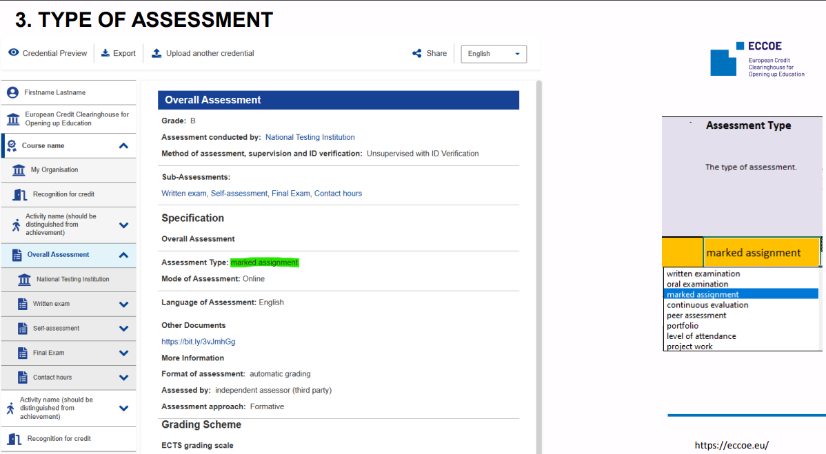
Type of Assessment

Slide 4
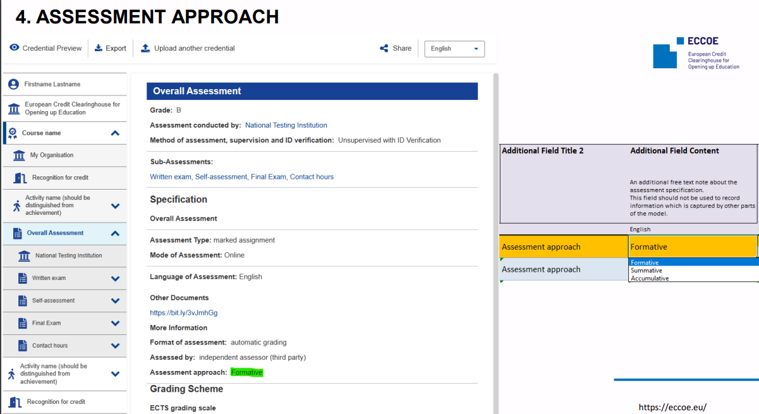
Assessment Approach

Slide 5
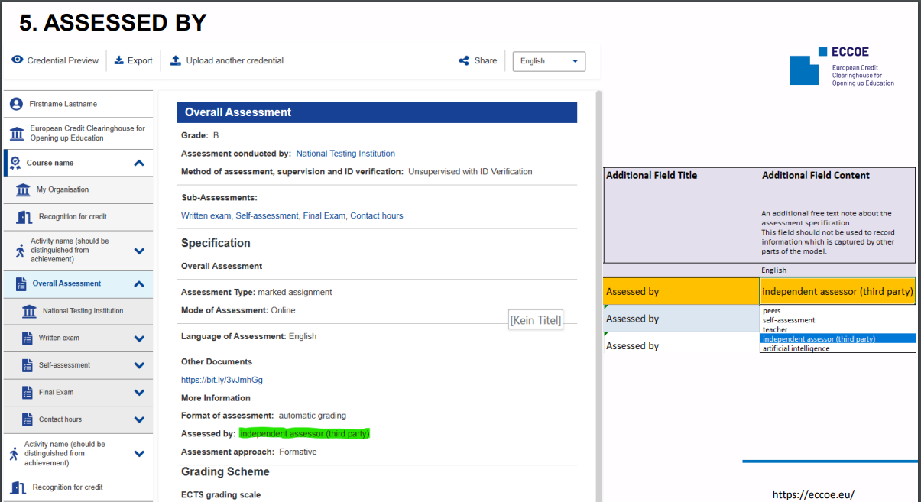
Assessed by

Slide 6
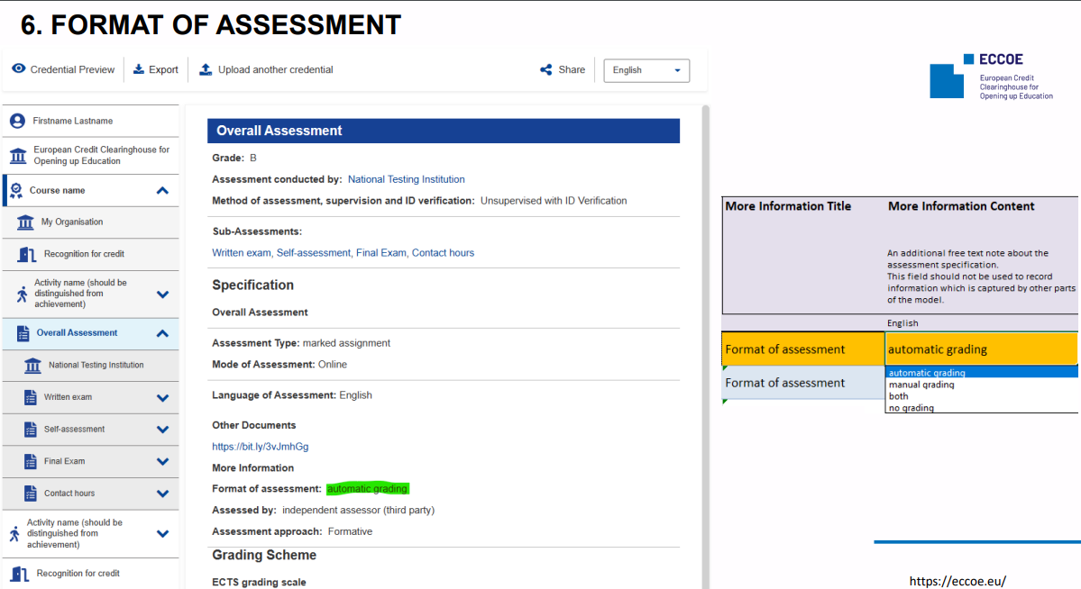
Format of Assessment

Slide 7
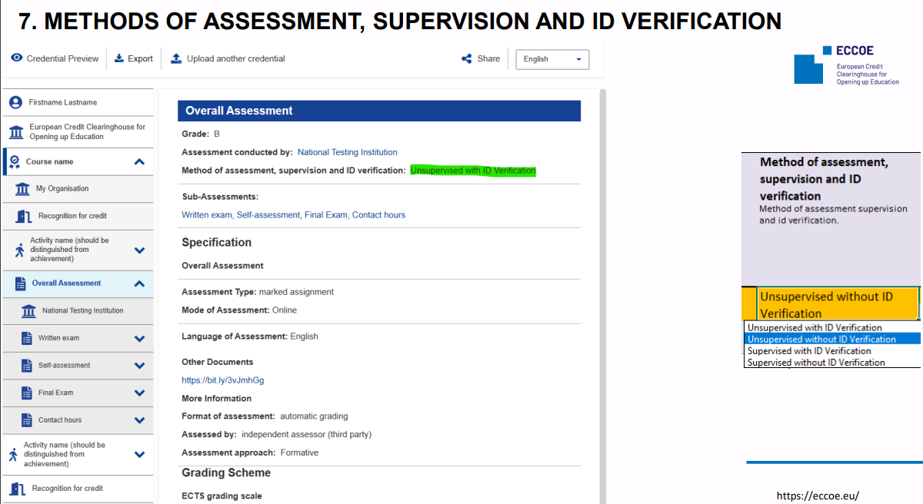
Assessment, Supervision and ID Verification

Slide 8
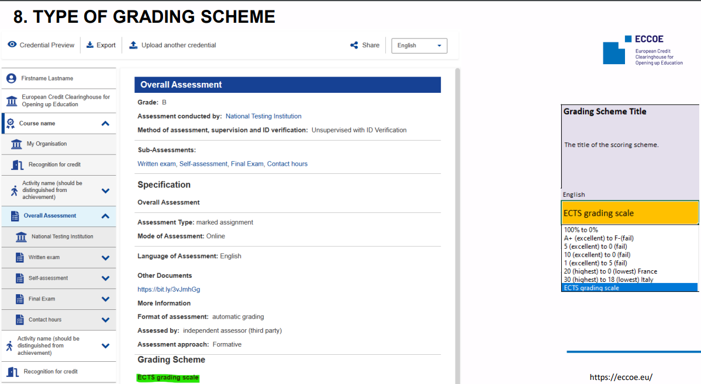
Type of Grading Scheme

Slide 9
To access the exemplary ECCOE template for setting up a MicroCredential, please create an Europass account and log in, then open the ECCOE model credential in EDCI viewer https://europa.eu/europass/digital-credentials/issuer/#/home
Transparent Assessment from ECCOE CREDENTIAL METADATA OPEN CONSULTATION How the ECCOE credential properties look in credential building template and on the credential preview 2022 https://eccoe.eu/wp-content/uploads/sites/28/2022/03/O4-OPC-Visual_context.pdf

Slide 10
Comments or Questions?
Please contact us for further ideas, questions or remarks on this training material ursula.goez@heilbronn.dhbw.de
Training material "Ensuring digital and micro-credentialization of learning as a part of transparent assessment for recognition of learning outcomes" by Göz U., Cepauskiene R., is licensed under a Creative Commons Attribution-ShareAlike 4.0 International License

