Slide 1
DigiProf project Training Material O3 Unit 2
Complementary Slides: Implementation of MicroCredentials
DHBW

Slide 2
Micro-Credentials in HE
EQF (2 slides)
EUROPASS (3 slides)
Constructive Alignment
Notes:
Due to team and personal issues, we experienced a stagnation in workflow and aim to recover the progress asap.

Slide 3
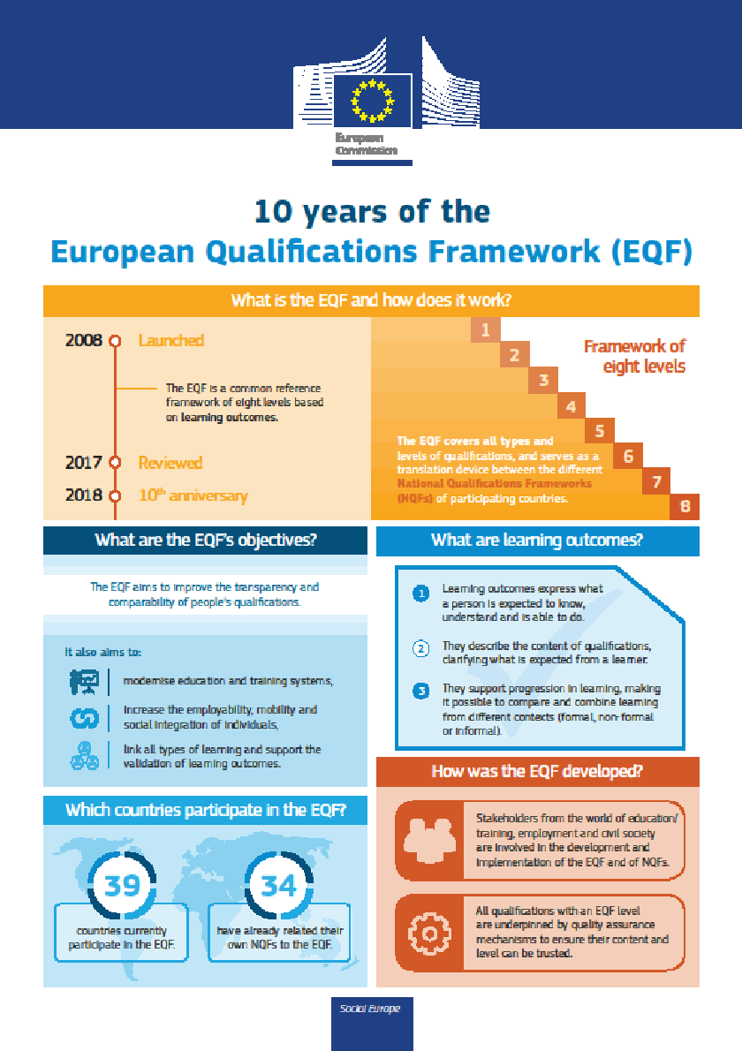
European Qualification Framework (1) from: EU Commission, The European Qualifications Framework: supporting learning, work and cross-border mobility, 10th anniversary, 2018. https://europa.eu/europass/en/document-library/eqf-brochure-and-infographic-english

Slide 4
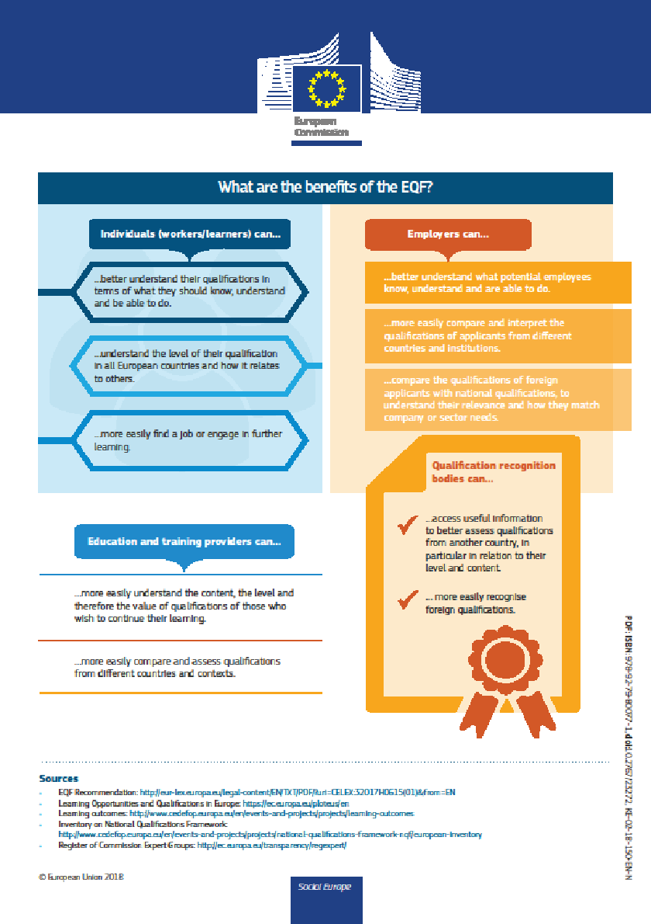
European Qualification Framework (2) from: EU Commission, The European Qualifications Framework: supporting learning, work and cross-border mobility, 10th anniversary, 2018. https://europa.eu/europass/en/document-library/eqf-brochure-and-infographic-english

Slide 5
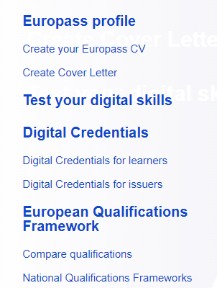
EUROPASS tools . https://europa.eu/europass/en

Slide 6
EUROPASS opportunity guidance . https://europa.eu/europass/en

Slide 7
Diploma Supplement: issued by higher education institutions and offers helpful information on higher education qualifications (e.g. grades, achievements, institution) in a standard format
Europass Certificate Supplement: issued by vocational education and training (VET) institutions and offers helpful information on your vocational qualifications (e.g. grades, achievements, institution) in a standard format
Europass Mobility: describes international experiences and skills developed while students are studying, working or volunteering abroad
European Digital Credentials framework (EDCI) allows institutions to issue digital, tamper-proof qualifications and other learning credentials, including MicroCredentials
EUROPASS documents to be issued . https://europa.eu/europass/en/stakeholders/education-and-training

Slide 8
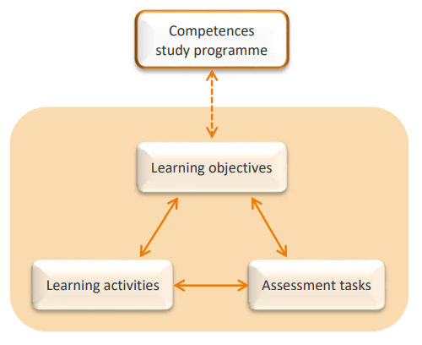
Constructive Alignment
after Biggs, J., Tang, C., & Kennedy, G. (2022). Teaching for quality learning at university

Slide 9
What is next?
Please contact us for further ideas, questions or remarks on Output 3: ursula.goez@heilbronn.dhbw.de
Training material "Ensuring digital and micro-credentialization of learning as a part of transparent assessment for recognition of learning outcomes" by Göz U., Cepauskiene R., is licensed under a Creative Commons Attribution-ShareAlike 4.0 International License

