Slide 1
DigiProf project Training Material Unit 1
Complementary Slides: Microcredentialisation process and concept
DHBW

Slide 2
Micro-Credentials in HE
The vision
The definition
Ecosystem I
Ecosystem II
Mapping Credentials
MC-Integration into Ed Landscape
Constructive Alignment
Notes:
Due to team and personal issues, we experienced a stagnation in workflow and aim to recover the progress asap.

Slide 3
The vision from ‚A European approach to micro-credentials – Output of the micro-credentials higher education consultation group - Final report’ https://education.ec.europa.eu/sites/default/files/document-library-docs/european-approach-micro-credentials-higher-education-consultation-group-output-final-report.pdf

Slide 4
The definition
from ‚A European approach to micro-credentials – Output of the micro-credentials higher education consultation group - Final report’ https://education.ec.europa.eu/sites/default/files/document-library-docs/european-approach-micro-credentials-higher-education-consultation-group-output-final-report.pdf

Slide 5
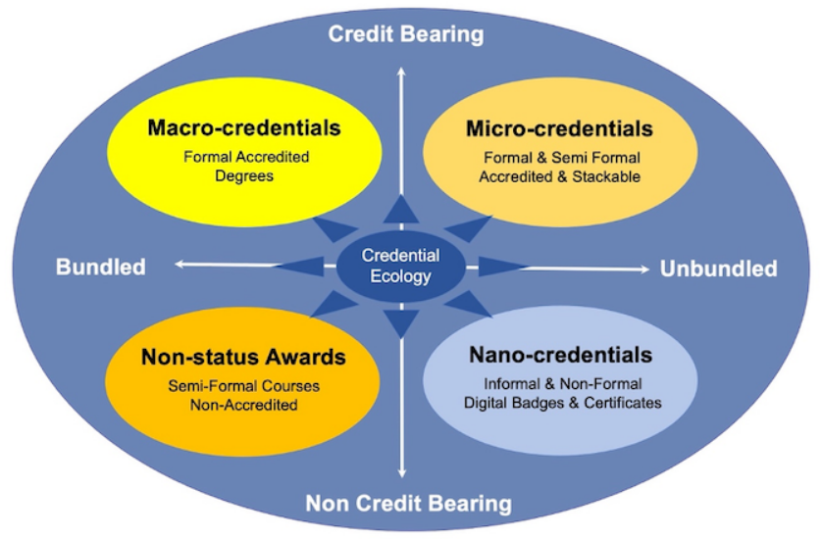
Mapping Credentials
from: Brown, M., Mhichil, M. N. G., Beirne, E., & Mac Lochlainn, C. (2021). The Global Micro-Credential Landscape: Charting a New Credential Ecology for Lifelong Learning. Journal of Learning for Development, 8(2), 228-254. https://jl4d.org/index.php/ejl4d/article/download/525/618?inline=1

Slide 6
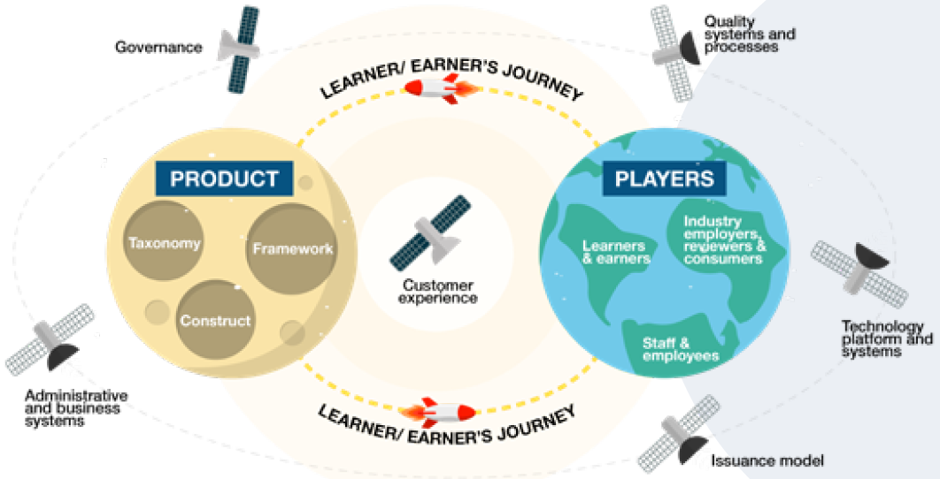
MicroCredential Ecosystem as a business model
from: DESIGNING AND IMPLEMENTING MICRO-CREDENTIALS: A GUIDE FOR PRACTITIONERS (Australia) https://oasis.col.org/colserver/api/core/bitstreams/770ff842-9a5e-424b-a253-0757fa539086/content

Slide 7
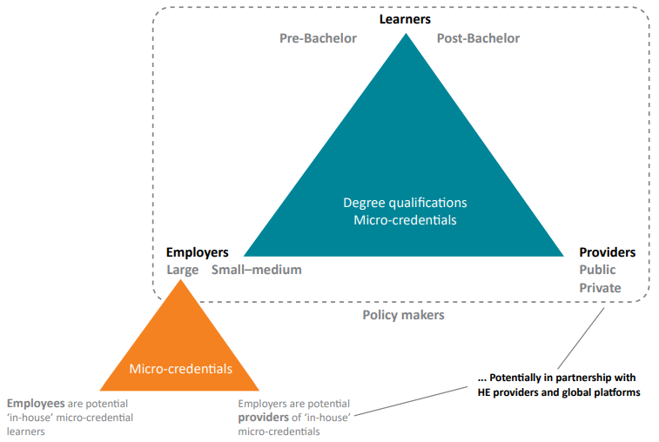
MicroCredential Ecosystem providers and possible links
from: Oliver, B. (2019). Making micro-credentials work for learners, employers and providers http://dteach.deakin.edu.au/2019/08/02/microcredentials/

Slide 8
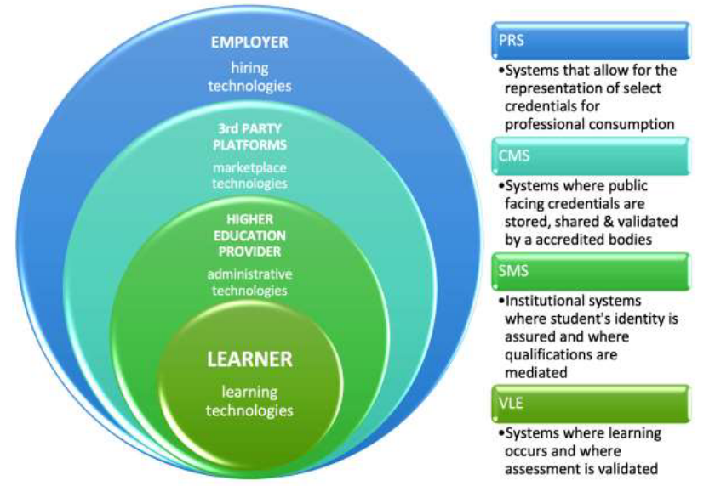
MicroCredential and Stakeholder Engagement with relevant technologies
from: Selvaratnam, R. M., & Sankey, M. (2021). An integrative literature review of the implementation of micro-credentials in higher education https://ojs.deakin.edu.au/index.php/jtlge/article/view/942/1019

Slide 9
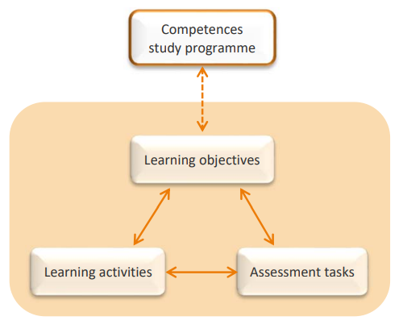
Constructive Alignment
after Biggs, J., Tang, C., & Kennedy, G. (2022). Teaching for quality learning at university

Slide 10
MicroCredential integration into Educational Landscape
from: BWP 51 (3), 35-39 https://www.bwp-zeitschrift.de/en/bwp_161471.php

Slide 11
What is next?
Please contact us for further ideas, questions or remarks: ursula.goez@heilbronn.dhbw.de
Training material "Ensuring digital and micro-credentialization of learning as a part of transparent assessment for recognition of learning outcomes" by Göz U., Cepauskiene R., is licensed under a Creative Commons Attribution-ShareAlike 4.0 International License

