Slide 1
OER presentation
Group 4. Task 1. Team - Fantastic Four
Team – Fantastic Four This work is licensed under a Creative Commons Attribution-NonCommercial-ShareAlike 3.0 Unported License.

Slide 2
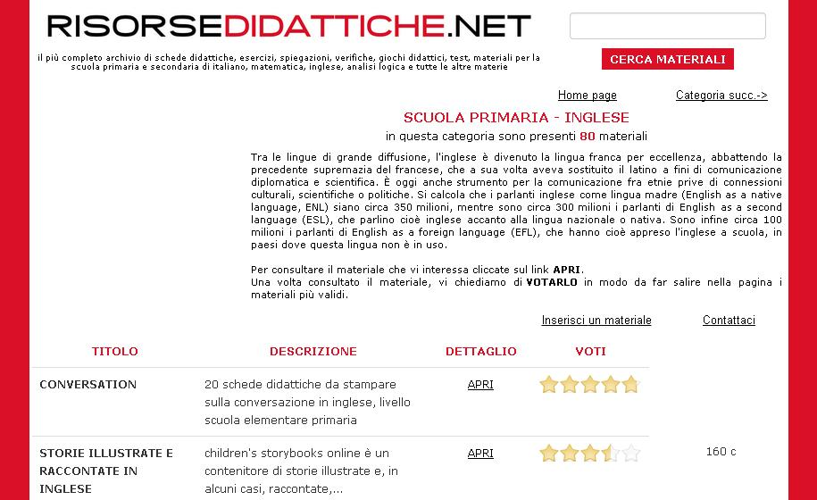
Italian repository of learning objects: http://www.risorsedidattiche.net/index.php
website containing educational material related to the primary school (about 15000 resources).
Team – Fantastic Four This work is licensed under a Creative Commons Attribution-NonCommercial-ShareAlike 3.0 Unported License.

Slide 3
Italian repository of learning objects: http://www.conquistaweb.it/risorse.htm
Website containing educational material (mainly cards, but also sounds, music and software) addressed to primary school.
Team – Fantastic Four This work is licensed under a Creative Commons Attribution-NonCommercial-ShareAlike 3.0 Unported License.

Slide 4
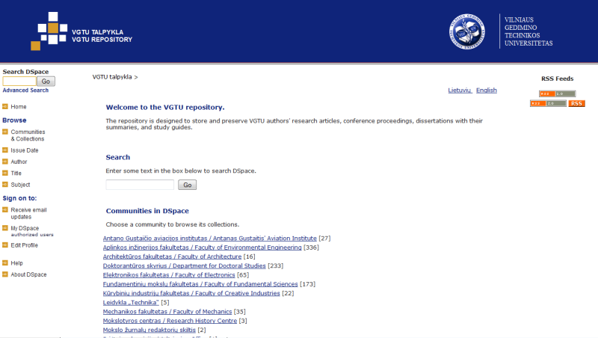
Lithuanian repository of learning objects: http://dspace.vgtu.lt
Vilnius Gediminas Technical University learning objects repository. More than 1500 resources.
Team – Fantastic Four This work is licensed under a Creative Commons Attribution-NonCommercial-ShareAlike 3.0 Unported License.

Slide 5
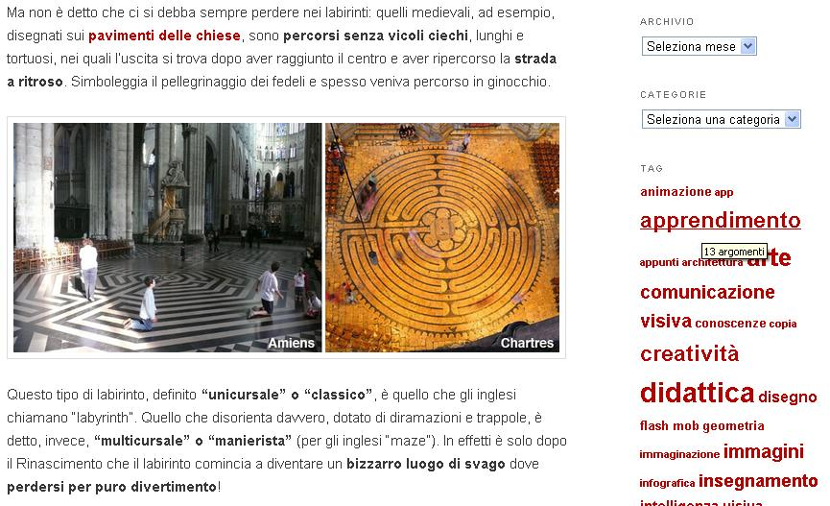
Italian educational blog: http://www.didatticarte.it/Blog/
Blog about drawing and history of art. The blog is part of a website:
http://www.didatticarte.it/home.html that is a repository of learning objects
Team – Fantastic Four This work is licensed under a Creative Commons Attribution-NonCommercial-ShareAlike 3.0 Unported License.

Slide 6
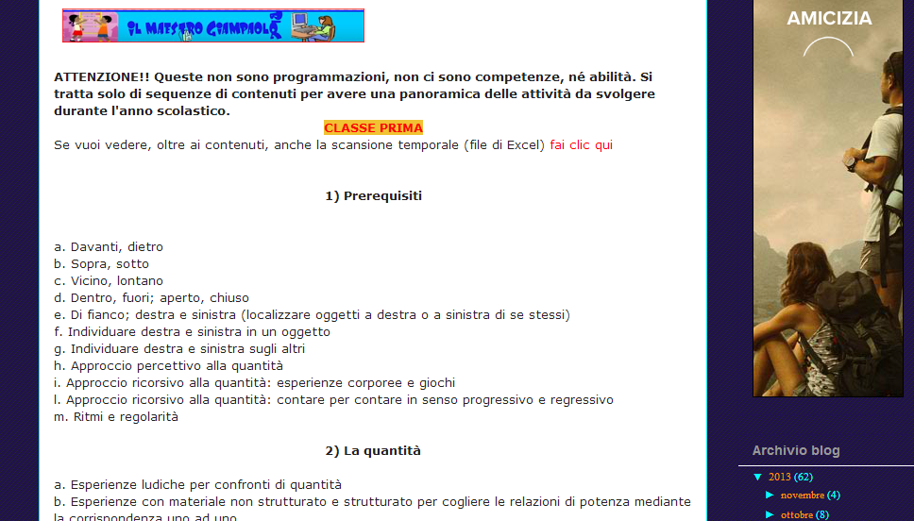
Italian educational blog: http://didatticamatematicaprimaria.blogspot.it
Blog on maths for primary school. The blog has also a repository of learning objects (mainly cards and images).
Team – Fantastic Four This work is licensed under a Creative Commons Attribution-NonCommercial-ShareAlike 3.0 Unported License.

Slide 7
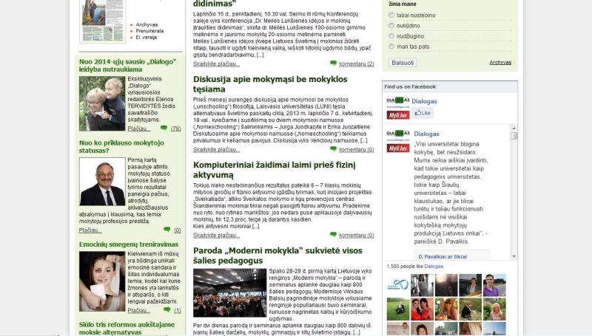
Lithuanian educational blog: http://www.dialogas.com
Blog/website about education. Interesting articles, news.
Team – Fantastic Four This work is licensed under a Creative Commons Attribution-NonCommercial-ShareAlike 3.0 Unported License.

Slide 8
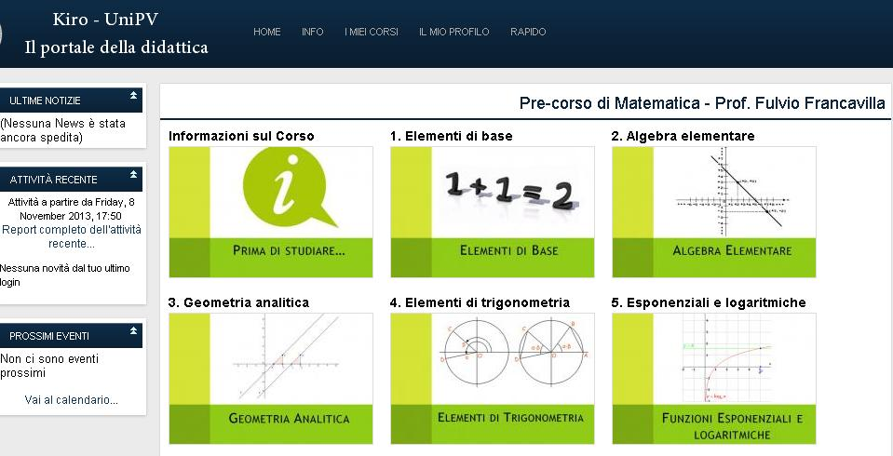
Italian OCW site: http://lotarionline.unipv.it/moodle/
Moodle platform containing materials related to courses of the University of Pavia. Some material is freely accessible to all, other is reserved to students.
Team – Fantastic Four This work is licensed under a Creative Commons Attribution-NonCommercial-ShareAlike 3.0 Unported License.

Slide 9
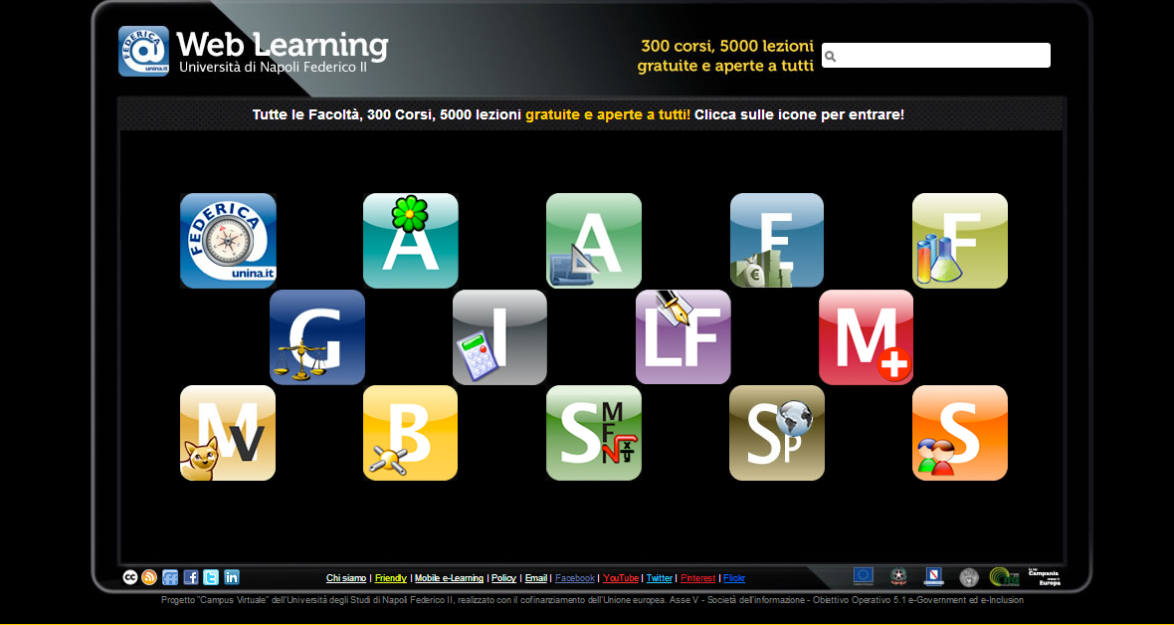
Italian OCW site: http://www.federica.unina.it/courseware/
Website of University “Federico II” of Naples. You can choose your faculty, your course and the topic.
Team – Fantastic Four This work is licensed under a Creative Commons Attribution-NonCommercial-ShareAlike 3.0 Unported License.

Slide 10
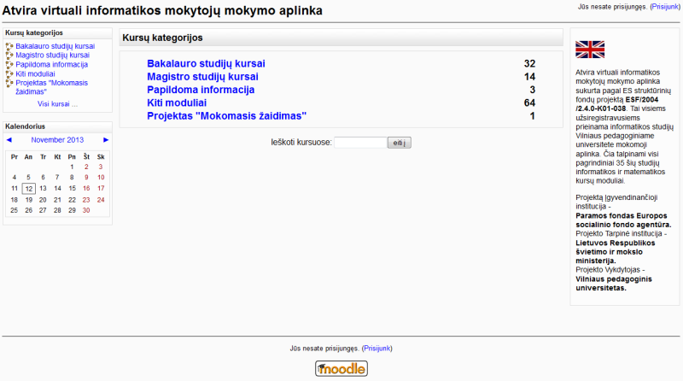
Lithuanian OCW site: http://www.estudijos.vpu.lt/
Lithuanian University of Educational Sciences. IT studies material provided as courses.
Team – Fantastic Four This work is licensed under a Creative Commons Attribution-NonCommercial-ShareAlike 3.0 Unported License.

Slide 11
Italian MOOC site: http://www.uninettunouniversity.net/it/MOOC.aspx
Consortium of Italian and foreign Universities offering MOOCs in different languages.
Team – Fantastic Four This work is licensed under a Creative Commons Attribution-NonCommercial-ShareAlike 3.0 Unported License.

Slide 12
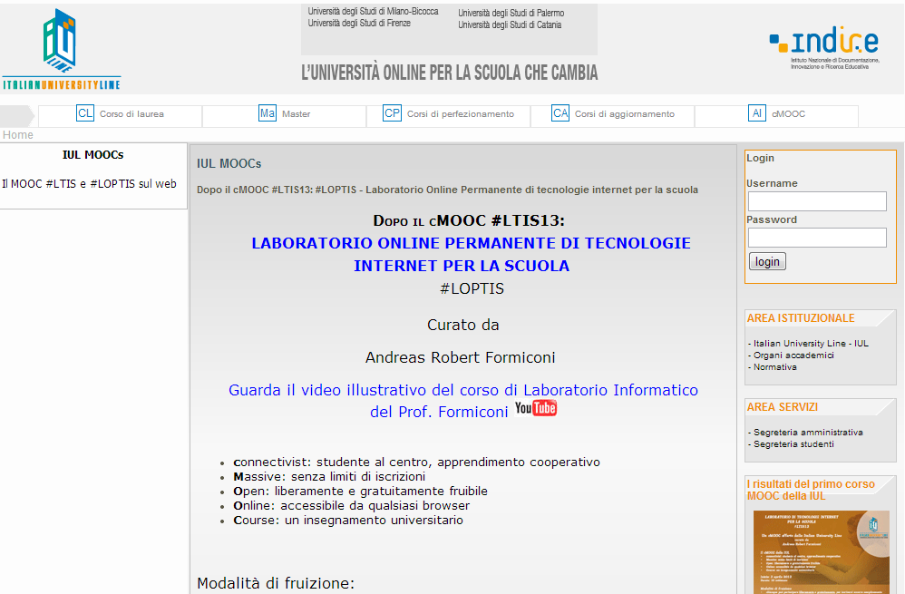
Italian MOOC site: http://www.iuline.it/ambiente/index.php?pag=corsi&id_corso=10
One MOOC course of Italian University Line.
Team – Fantastic Four This work is licensed under a Creative Commons Attribution-NonCommercial-ShareAlike 3.0 Unported License.

Slide 13
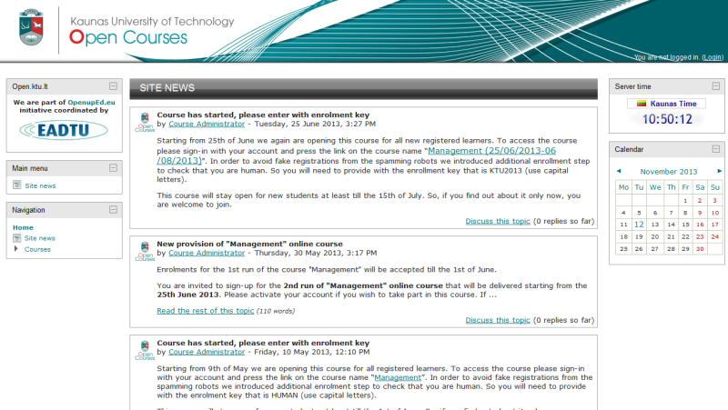
Lithuanian MOOC site: http://open.ktu.lt/
Kaunas Technology University Open. Only one course for now. This course available at http://www.openuped.eu/
Team – Fantastic Four This work is licensed under a Creative Commons Attribution-NonCommercial-ShareAlike 3.0 Unported License.

