Slide 1
OER presentation
Group 4. Task 1. Team - Fantastic Four
Team – Fantastic Four This work is licensed under a Creative Commons Attribution-NonCommercial-ShareAlike 3.0 Unported License.

Slide 2
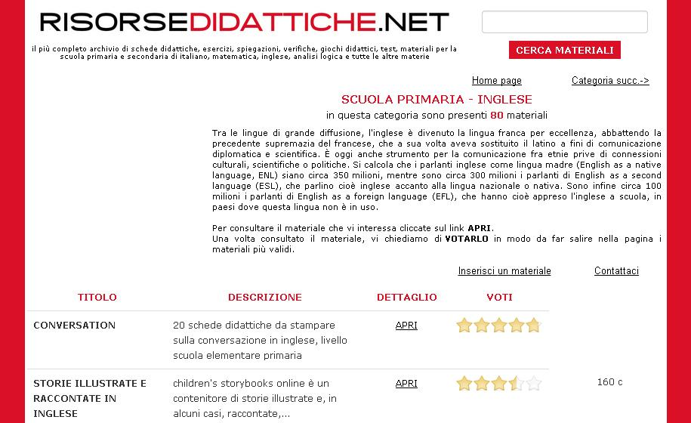
Italian repository of learning objects: http://www.risorsedidattiche.net/index.php
website containing educational material related to the primary school (about 15000 resources).
Team – Fantastic Four This work is licensed under a Creative Commons Attribution-NonCommercial-ShareAlike 3.0 Unported License.

Slide 3
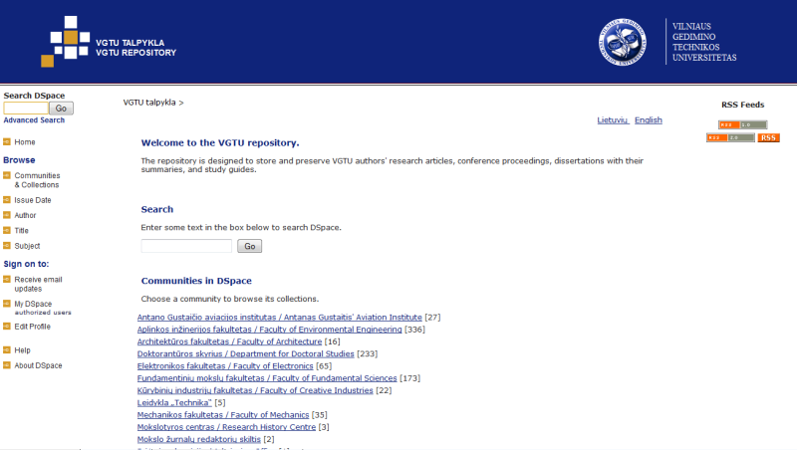
Lithuanian repository of learning objects: http://dspace.vgtu.lt
Vilnius Gediminas Technical University learning objects repository. More than 1500 resources.
Team – Fantastic Four This work is licensed under a Creative Commons Attribution-NonCommercial-ShareAlike 3.0 Unported License.

Slide 4
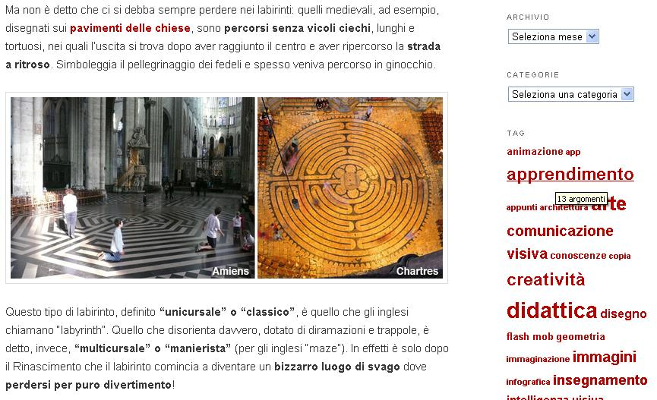
Italian educational blog: http://www.didatticarte.it/Blog/
Blog about drawing and history of art. The blog is part of a website:
http://www.didatticarte.it/home.html that is a repository of learning objects
Team – Fantastic Four This work is licensed under a Creative Commons Attribution-NonCommercial-ShareAlike 3.0 Unported License.

Slide 5
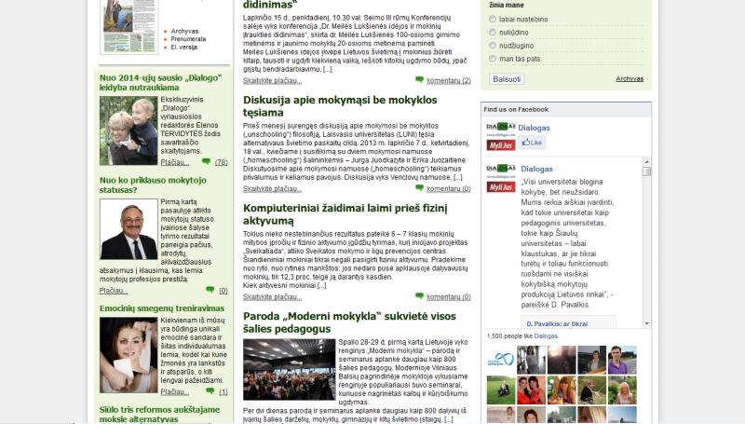
Lithuanian educational blog: http://www.dialogas.com
Blog/website about education. Interesting articles, news.
Team – Fantastic Four This work is licensed under a Creative Commons Attribution-NonCommercial-ShareAlike 3.0 Unported License.

Slide 6
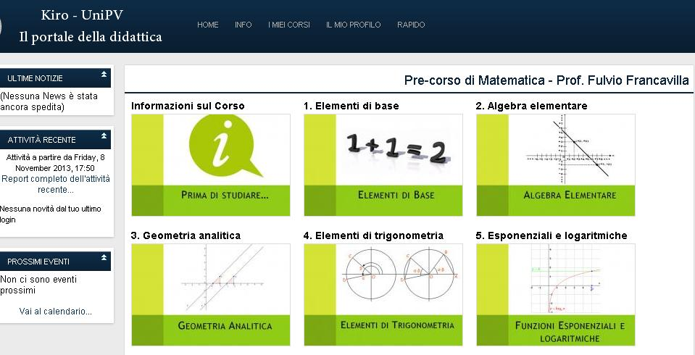
Italian OCW site: http://lotarionline.unipv.it/moodle/
Moodle platform containing materials related to courses of the University of Pavia. Some material is freely accessible to all, other is reserved to students.
Team – Fantastic Four This work is licensed under a Creative Commons Attribution-NonCommercial-ShareAlike 3.0 Unported License.

Slide 7
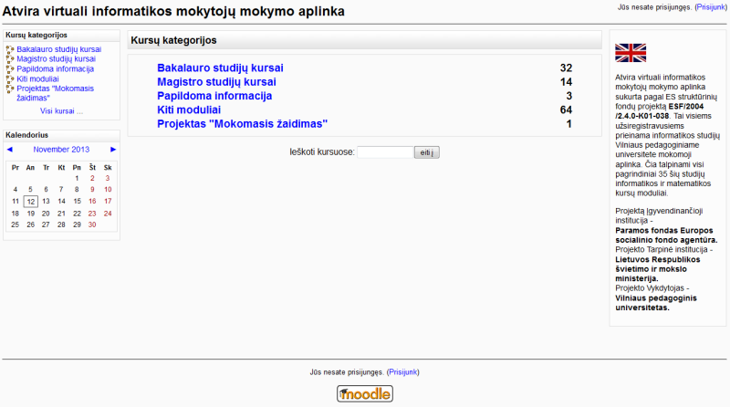
Lithuanian OCW site: http://www.estudijos.vpu.lt/
Lithuanian University of Educational Sciences. IT studies material provided as courses.
Team – Fantastic Four This work is licensed under a Creative Commons Attribution-NonCommercial-ShareAlike 3.0 Unported License.

Slide 8
Italian MOOC site: http://www.uninettunouniversity.net/it/MOOC.aspx
Consortium of Italian and foreign Universities offering MOOCs in different languages.
Team – Fantastic Four This work is licensed under a Creative Commons Attribution-NonCommercial-ShareAlike 3.0 Unported License.

Slide 9
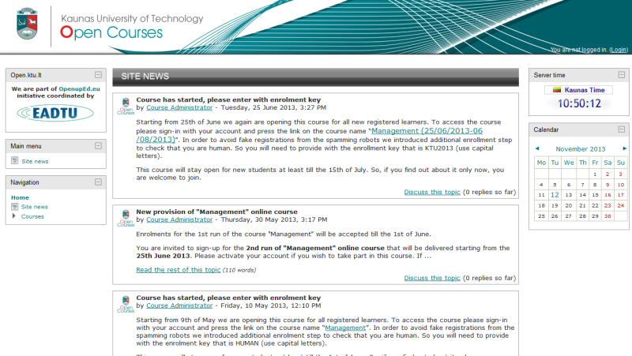
Lithuanian MOOC site: http://open.ktu.lt/
Kaunas Technology University Open. Only one course for now. This course available at http://www.openuped.eu/
Team – Fantastic Four This work is licensed under a Creative Commons Attribution-NonCommercial-ShareAlike 3.0 Unported License.

