Slide 1
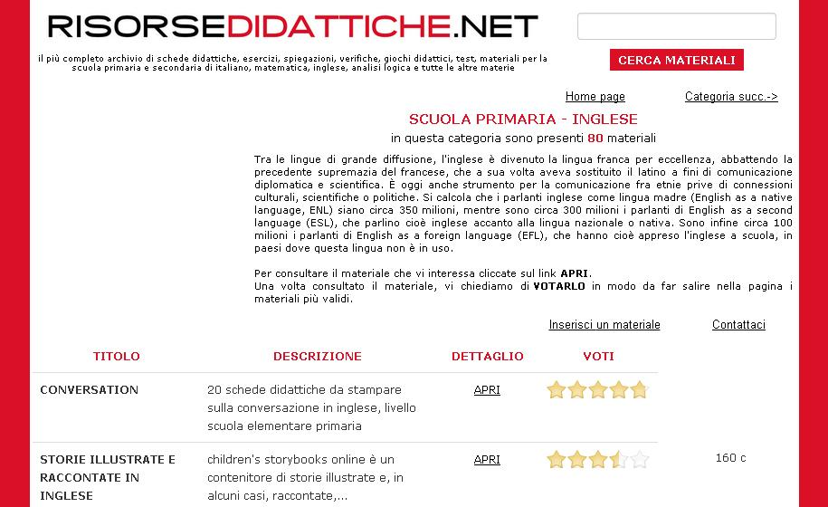
Italian repository of learning objects: http://www.risorsedidattiche.net/index.php
website containing educational material related to the primary school (about 15000 resources).

Slide 2
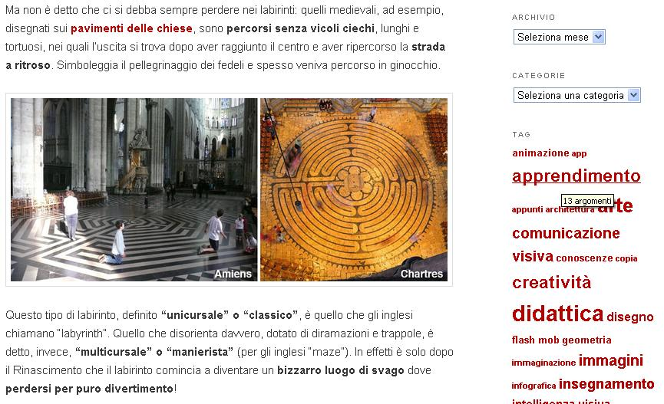
Italian educational blog: http://www.didatticarte.it/Blog/
Blog about drawing and history of art. The blog is part of a website:
http://www.didatticarte.it/home.html that is a repository of learning objects

Slide 3
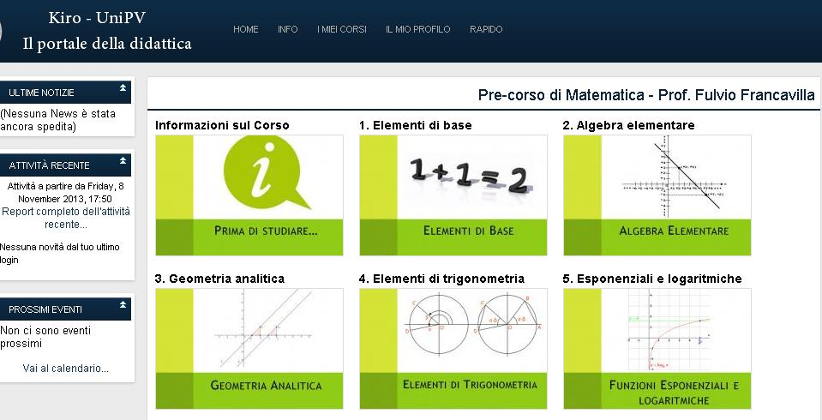
Italian OCW site: http://lotarionline.unipv.it/moodle/
Moodle platform containing materials related to courses of the University of Pavia. Some material is freely accessible to all, other is reserved to students.

Slide 4
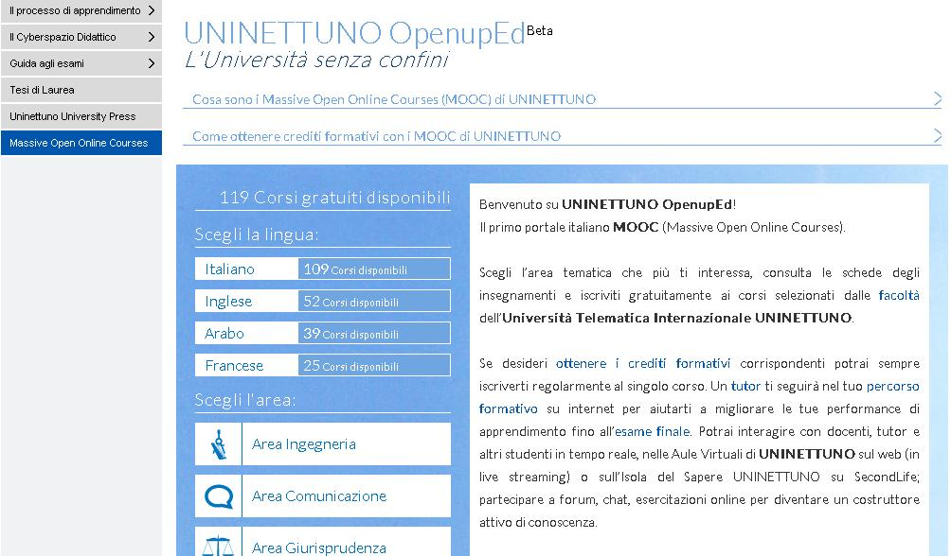
Italian MOOC site: http://www.uninettunouniversity.net/it/MOOC.aspx
Consortium of Italian and foreign Universities offering MOOCs in different languages.

