Slide 1
Love Earth to the Moon and Back: Development of ECurriculum on Climate Change and Environmental Education for Secondary Education Students in Online Learning Platform 2021-1-CZ01-K220-SCH-000034484

Slide 2
Age of target students: 15+ Teaching time: 2 hours Disciplines: Geography, Human Sciences, Maths, Science, Technology
Competences Promoted :
1.Communication in foreign languages competency - CLIL -
2.Mathematical competency and basic competencies in science/technology – STEAM -
3.Social and citizenship-related competencies
4. Cultural and lingual awareness and expression competencies

Slide 3
1- The Lesson Content : The effects of exploitation of natural resources
Topic : The effects of exploitation of natural resources. Why is it critical to manage the natural resources efficiently?
Title : The different uses and exploitation of natural resources.
Level: Knowledge ; Awareness ; Skills; Participation

Slide 4
2-Objectives :
Developing students’ Systems–thinking competence; anticipatory ( future thinking ) competence; interpersonal competence - collaboration competence- ; critical thinking competence; integrated problem solving competence
The lesson objectives :
They discuss and comprehend the effects of exploitation of natural resources.

Slide 5
3. Learning - Teaching Processes :
Online teaching material: youtube videos, newspaper news, research report
Resources used : Text, multimedia (audio material), worksheet.
e_Materials/ Technology : google translate, grammarly, citation generator
Learning – Teaching Styles : Collaborative learning , Peer learning , Student centered learning, Open Source Learning
Teaching Methods/ Techniques: Brainstorming ; Case-Based Small-Group Discussion; Translation; Group work ; Presentation and Questioning

Slide 6
Ice Breaker : Students are invited to play Apple – Banana- Orange.
INSTRUCTIONS: Form a circle and put your hands on the shoulders of the person in front.
Jump forward at the same time (don’t break the circle) when I say APPLE
Jump backward at the same time (don’t break the circle) when I say ORANGE
Jump back turning 180 degree and put your hands over the shoulders of the person behind when I say BANANA

Slide 7
ENGAGE
“I perhaps owe having become a painter to ____ .”

Slide 8
ENGAGE
Listen and fill in the blanks with the correct words . The words are in Turkish but do not worry, trust your EARS.
soğan- karanfil – domates – biber – patlıcan - karayemişa - çami - kınayı
1."___________, __________, ____________"
"___________, __________, ____________"
Bir anda bütün dünyam karardı, Bu sesle sokaklar yankılandı
"___________, __________, ____________"

Slide 9
Listen and fill in the blanks with the correct words . The words are in Turkish but do not worry, trust your EARS.
soğan- karanfil – domates – biber – patlıcan - karayemişa - çami - kınayı
2.Haberin var mı taş duvar? Demir kapı, kör pencere, Yastığım, ranzam, zincirim,
Uğruna ölümlere gidip geldiğim, Zulamdaki mahzun resim,
Görüşmecim, yeşil __________ göndermiş,
__________ kokuyor cıgaram
Dağlarına bahar gelmiş memleketimin...

Slide 10
Listen and fill in the blanks with the correct words . The words are in Turkish but do not worry, trust your EARS.
soğan- karanfil – domates – biber – patlıcan - karayemişa - çami - kınayı
3. İçim buruk biraz arkadaşlar, Ayrılıyorum sizden
Dolaşırken mekan mekan, Beni ararsınız evden
___________ yakmışlar geline, Hazırlanmış gidiyor evine
Başında al yazması var, Ağlıyor bakmayın yüzüne

Slide 11
Listen and fill in the blanks with the correct words . The words are in Turkish but do not worry, trust your EARS.
soğan- karanfil – domates – biber – patlıcan - karayemişa - çami - kınayı
4. Hayde gidelum hayde, Hayde gidelum hayde,Hayde gidelum hayde
Dağa ____________, Dağa ____________, Dağa ____________,
Elun nişanlısına, Elun nişanlısına,Elun nişanlisina
Ben nasil deyim hayde, Ben nasil deyim hayde,Ben nasil deyim hayde
Çiktum ______ budadum, Çiktum_______ budadum, Çiktum ______ budadum
Endurdum yarisina,Endurdum yarisina,Endurdum yarisina
Böyle sevdamu olur, Böyle sevdamu olur, Böyle sevdamu olur
Girsin yerin dibuna, Girsin yerin dibuna, Girsin yerin dibuna

Slide 12
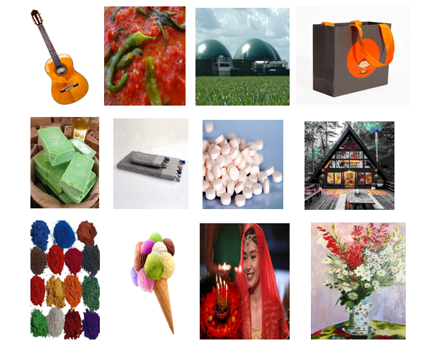

Slide 13
EXPLORE
Questions for Discussion:
1.Look at the photos. What do you think they have in common ?
2. Can you connect those photos with the key words in Activity 1? How are they connected?
3. What is the natural resource we focus on? What are the different uses of that natural resource?

Slide 14
EXPLAIN
Answer the questions
1.Plants have special round, flat organelles called c__________. They are arranged in stacks called g________
2. What gives leafy green plants their green color is c__________ in those stacks.
3. The chlorophyll is activated by __________creating an energy that splits molecules of water, separating them out into ___________ and _____________.
4. Plants combine __________ from the water with ___________ we breathe out. __________ is released into the air.
5. That process by which plants use sunlight, water, and carbon dioxide to release _________ and ________ is called p____________.

Slide 15
Plants Are Producers .
People are consumers. We have to spend large parts of our days fi nding, buying, cooking and eating our food. Did you ever think it might be nice to be able to make your own food like plants do? Plants are producers and perform a process called photosynthesis using light from the sun, water and carbon dioxide. Carbon dioxide is the gas we exhale when we breathe. The end result of this chemical reaction is sugar for the plant to “eat.” The plant releases water and oxygen, a gas all animals need to breathe, into the air.
.

Slide 16
So how do plants do it, and why can’t we? Plants have special structures called chloroplasts that animals don’t have. Chloroplasts are round, flat organelles that are arranged in stacks called grana. These stacks are filled with chlorophyll. Chlorophyll is what gives leafy green plants their green color. Their main job is to absorb light from the sun. Chloroplasts can absorb every color except green. Light activates the chlorophyll. It creates an energy that splits molecules of water, separating them out into hydrogen and oxygen. Chemical reactions take place. Hydrogen from the water combines with carbon from the carbon dioxide we breathe out. Oxygen is released into the air.

Slide 17
People and plants make perfect partners. Plants rely on the carbon dioxide that we breathe out, and we rely on the oxygen that they “breathe” out. This is one good reason for protecting plant life on Earth. Algae fields near the poles produce a constant supply of oxygen for us. So do the many plants of Earth’s rainforests. We need plants in order to survive.
Conservation projects around the globe are aimed at protecting our natural resources, including numerous species of plants. Our quality of life and the very quality of the air we breathe depends upon our green plant partners.
Copyright ©2012 K12Reader - http://www.k12reader.com

Slide 18
EXPLAIN (Answers)
1.Plants have special round, flat organelles called chloroplasts . They are arranged in stacks called grana
2. What gives leafy green plants their green color is Chlorophyll in those stacks.
3. The chlorophyll is activated by light creating an energy that splits molecules of water, separating them out into hydrogen and oxygen.
4. Plants combine hydrogen from the water with carbon we breathe out. Oxygen is released into the air.
5. That process by which plants use sunlight, water, and carbon dioxide to release water and oxygen is called photosynthesis

Slide 19
II. Explain the end-text questions please.
-Explain why plants are called producers. What do they do ?
-Explain the relationship between people and plants. Why are we good partners?
-What would happen if there were not enough plants on Earth?

Slide 20
EXTEND
Prepare a fact sheet draft with statistics and numbers on forest resources of France, Turkey, Czeckia, Lithuania, Austria, Iceland and Poland. Create your sheet in six parts within social, political, economical and ecological perspectives

Slide 21
1.Part: Forest Features mentioning the location, area, tree/plant species …etc (its ecological value)
2.Part: Forest History mentioning the residents of the forest ( which societies and language groups is it home to? ( = its social function)
3. Part: Forest Sources and Uses mentioning what is made of its sources ( = its economic value)
4. Part: Forest Further Uses mentioning its effects on disasters by answering if it decreases the impacts of natural disasters ( =its added value)
5. Part: Forest Management mentioning the goals and practices of forest management as well as management standards and rules ( the policies and regulations in forest management )
6. Part: Forest Sources’ Uniqueness mentioning the importance of forest sources and the recommendations for forest conservation.

Slide 22
While creating your fact sheet, visit scan and skim the contents of the websites supplied
The news on Disasters: https://www.theguardian.com/world/natural-disasters
The Research Report on Forests and Disasters: https://www.jstor.org/stable/resrep29725.9?seq=1
The Importance of Forests | How to protect Forests - YouTube

Slide 23
The List of the Benefits of the Forests
1.Forests address climate change Forests are also the source of renewable biofuels.
2. Forests are habitat of plant and animal species at risk.
3. Forests deliver ecosystem services; they support soil nutrient cycle, purify air and water, mitigate disasters
4. Forests provide renewable products and support circular economy that minimizes the use of non-renewable resources.
5. Forests sustain communities and economies with opportunities for careers and local initiatives.
6. Forests are places to discover and understand our connection with the natural world and build environmental skills and values
7. Forests have social and cultural benefits for spiritual renewal.
8. Forests have healing effects ; they lower the rates of asthma and respiratory illnesses purifying the urban air.
9. Forets lower the temperature of urban heat islands with shade and by transpiring the moisture into the air.
10. Forests are the source of new medicines and traditional plant-based medicines.

Slide 24
Study the list of benefits of forests supplied. Revise your draft and support it with that list if required. Finalise your draft using grammarly and citation generator (or their alternative tools ) to organise your fact sheet correctly and ethically right. Please note that your fact sheet will be put into the ‘Policy Recommendations Book’ and delivered to the policy makers

Slide 25
EVALUATE
The List of the Different Uses of the Natural Resource of _______
1.
2.
3.
4.
5.
6.
7.
8.

Slide 26
EVALUATE ( ANSWERS)
The List of the Different Uses of the Natural Resource of Plants
1.Food: vegetables, fruit, meat, eggs, dairy, etc.
2.Oxygen: plants make this through photosynthesis
3.Industry: Clothing ( cotton jeans and rayon fabric), Paper, Furniture, Cosmetics ( plant dyes, plant oil fragrances, Shelter( lumber from trees and straw bales for homes)
4.Medicine: herbal teas, cancer treatment medicines developed from bark of the Yew tree, active ingredient in aspirin was developed from the bark of willow trees, etc.
5.Disasters: landslide, erosion, flood, drought
6.Beliefs: Sacred plants in folklore, native plants
7.Energy sources: biofuel, firewood, etc. 8. Art – Leisure : Lİterature, drawing, music…etc

Slide 27
ENDING THE LESSON
Natural Resources are riches that are influenced by certain conditions in their formation. Animals, water, stones, sunlight , air, soil, natural gas, coal and metals make up the Earth's natural resources
Watch the video and think over : ‘If we remove the natural resources from this video, what is left?’
https://www.youtube.com/watch?v=-Y0-qyIBjvI

Slide 28
https://www.youtube.com/watch?v=5tgNtIUOL4E

Slide 29
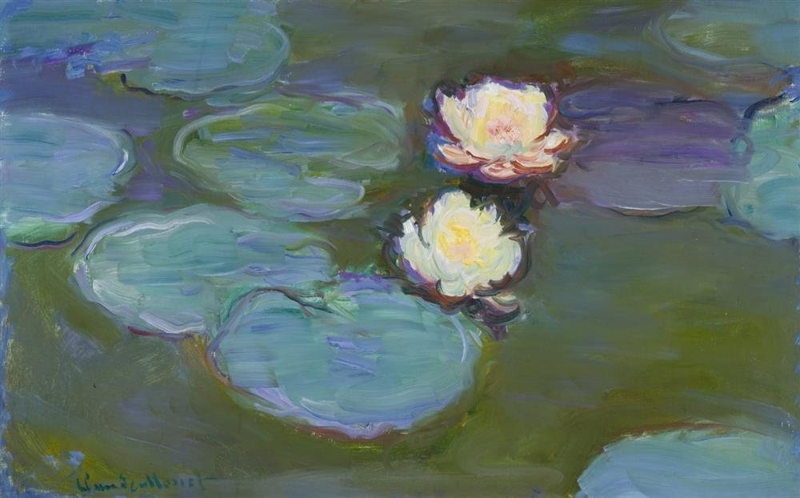
‘I perhaps owe having become a painter to flowers.’
Claude Monet

Slide 30
Love Earth to the Moon and Back: Development of ECurriculum on Climate Change and Environmental Education for Secondary Education Students in Online Learning Platform 2021-1-CZ01-K220-SCH-000034484
Thank you

